Slide 1
Integrating and Streamlining RTCQI Approaches in Non-conventional HIV Testing Settings: Synopsis of The Nigerian Community Testing Program
At The RTCQI Best Practice Workshop – Western Hemisphere, Panama City, Panama
Date: August 26-30, 2024

Slide 2
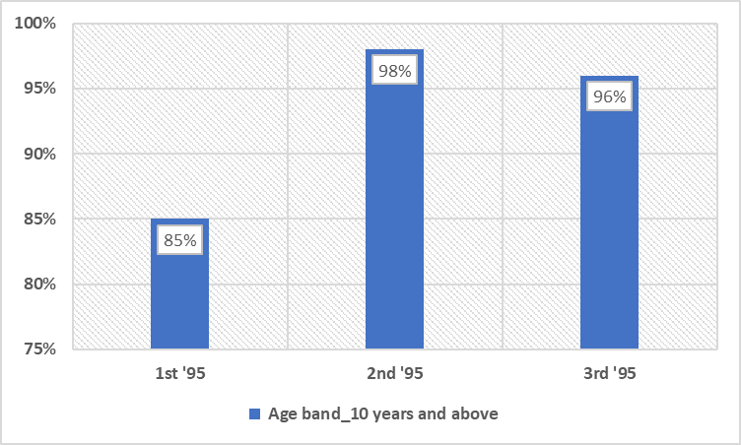
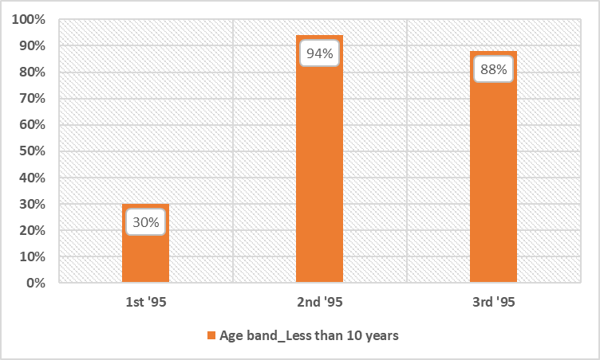
UNAIDS Targets: Nigeria as at December 2023
Source: National HIV/AIDS, Viral Hepatitis and STIs Control Programme (NASCP), Federal Ministry of Health (FMoH), Nigeria, 2023

Slide 3
Situational Analysis for Women Living with HIV in Nigeria
HIV prevalence among women was 51% in 2016 (represeting1.6 million)
Mother-to-child transmission accounts for about 10% of new HIV infections annually in Nigeria (Ozim et al., 2023).
HIV testing during pregnancy remains below the 95% national target (Ajayi et al., 2021).
Global pooled prevalence of syphilis in pregnant women was 0.8%. Higher in low-income countries (3.3%) and LMIC (1.5%) (Wu et al., 2023).
The prevalence of maternal syphilis in Nigeria was reported as 1.4% in 2016 (Adeyinka et al. (2018).
Ozim et al. 2023: https://doi.org/10.1136/bmjopen-2021-050164
Wu et al. 2023: https://doi.org/10.1016/j.cmi.2023.03.002.
Ajayi et al. 2021: https://doi.org/10.1093/pubmed/fdz152 .
Adeyinka et al. (2018): https://doi.org/10.1177/1403494817744988.

Slide 4
Considerations
Approaches tilt towards taking the test to the people.
Conduct HIV testing in non-conventional settings.
Provides services to people unwilling or unable to access testing services ordinarily.
Reduce the unmet needs.
Reducing Vertical transmission of HIV.
Epidemic control of HIV

Slide 5
Beneficiaries of HIV Testing in Non-conventional Settings
Pregnant Women
Biological Children of HIV index clients
Orphan and Vulnerable Children
Pediatrics and Adolescents
Key population and their social networks

Slide 6
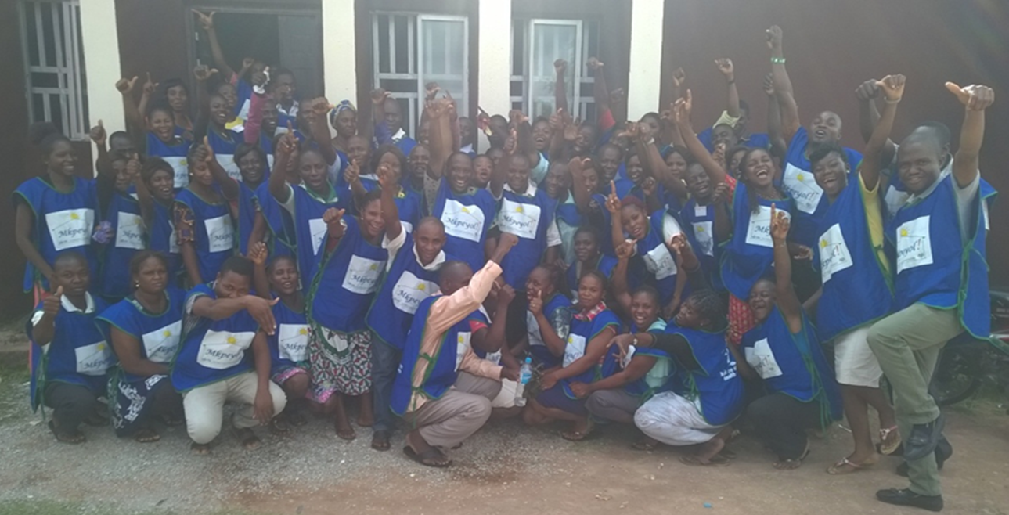
Integrated Testing Setting – 'Mkpeyol’ (TiV word for ‘Health for All’)
Implemented Innovative ‘Door to Door’ HIV Testing Service (HTS) – February- September 2016.
At the commencement of the Test and Treat, and RTCQI

Slide 7
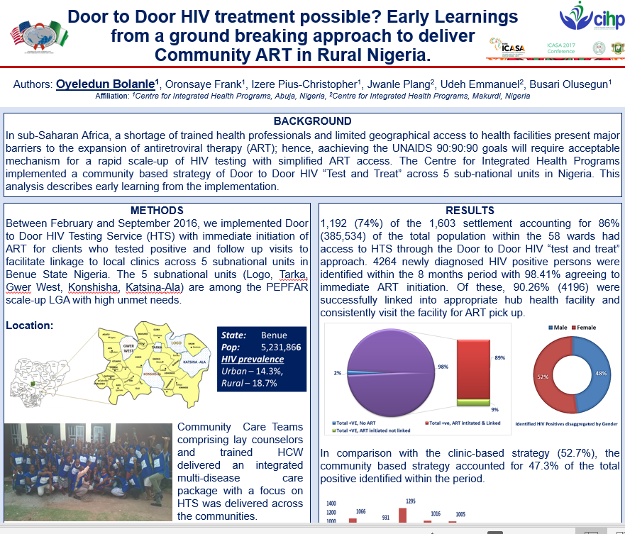
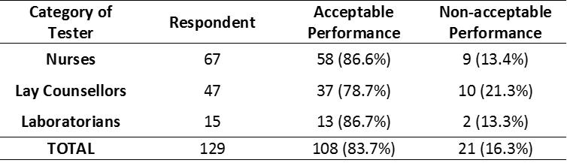
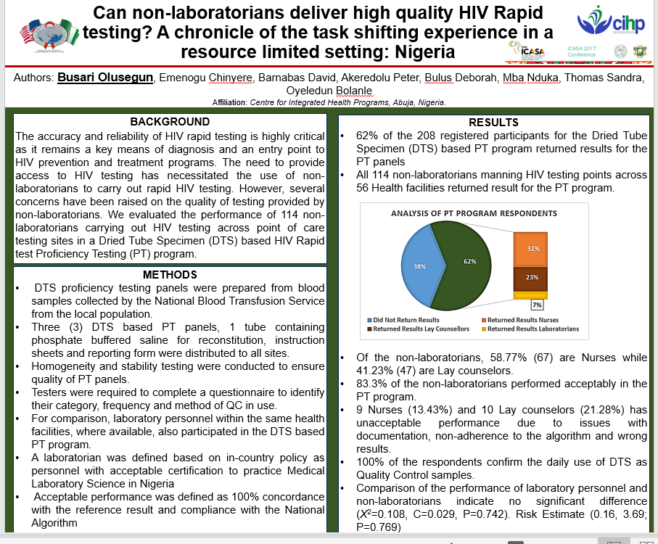
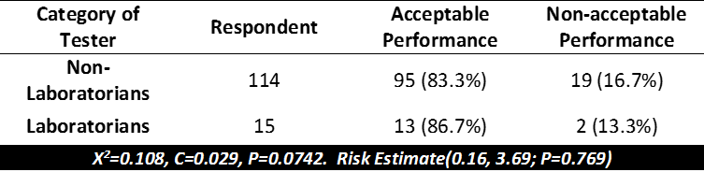
Early Intervention and Learnings
Some of the Early Learnings on the ‘Door to Door’ HIV and Skill Transfer:
Table I: Category of Respondent and Performance in the PT Program
Table II: Comparison of the performance of Laboratorians and Non-laboratorians

Slide 8
Current Programmatic Response – Testing in Non-Conventional Setting
Out-of-the-facility community targeted outreaches and testing
Community PMTC (cPMTC)
Home-based and Congregational Settings/NINERELA+
One Stop Shop (OSS)
- KP program
Reaching the Underserved
Community ART (CART) Team and CBOs
– Test and Treat
Home-based Testing and Self-Testing
Persons who will not visit the facility ordinarily
Notes:
Community ART Team (CART)
Community-based Organizations (CBOs)
Nigeria Network of Religious Leaders Living with or Personally Affected by HIV/AIDS (NINERELA+): Mother Love Party and Baby Shower.

Slide 9
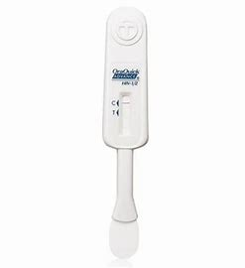

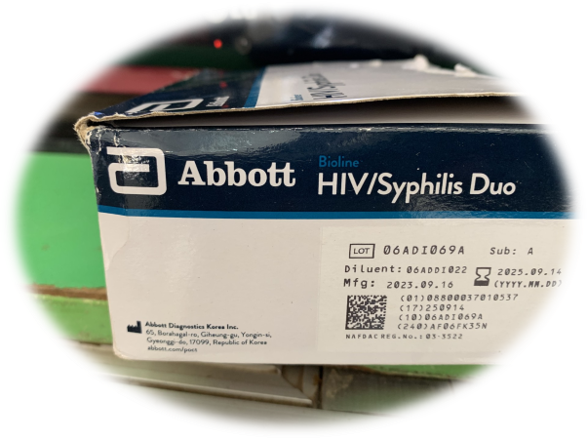
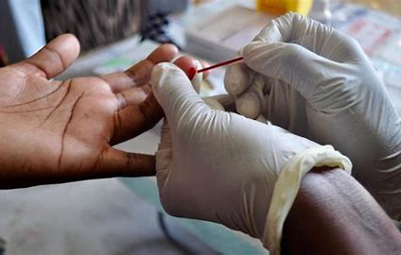
HIV Testing Methods in Non-conventional Settings
HIV Self Testing
A
HIV/Syphilis Duo/Combo
B
C
National Algorithm

Slide 10
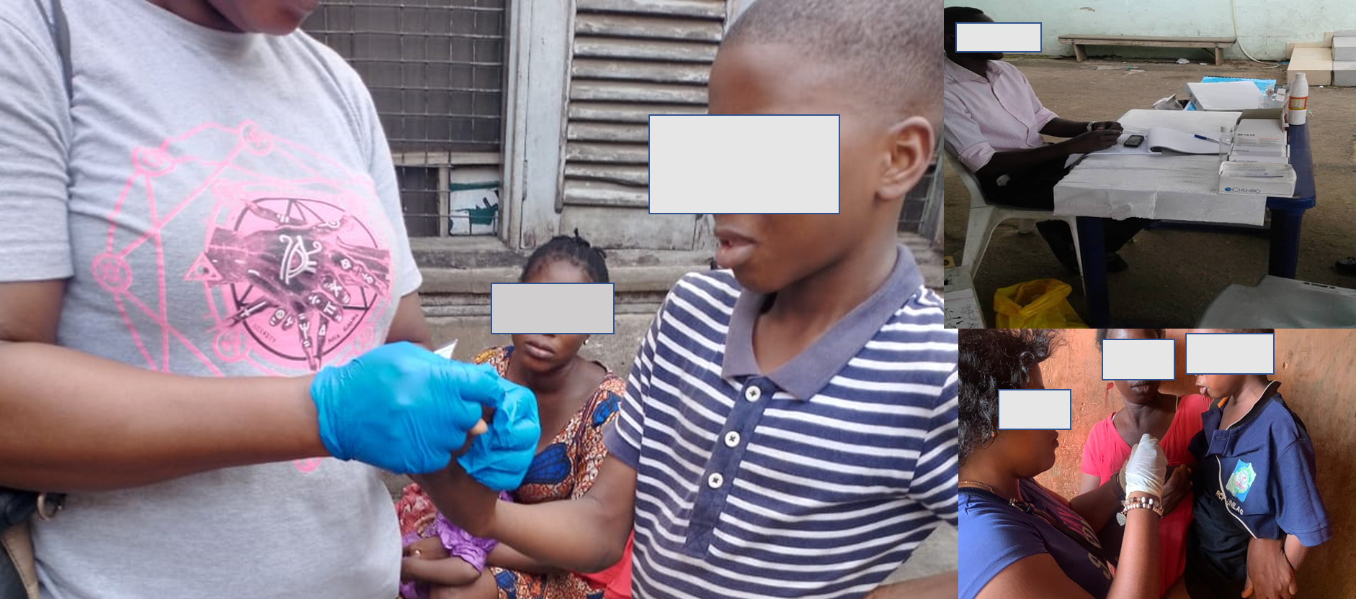
Testing Settings at the Community

Slide 11
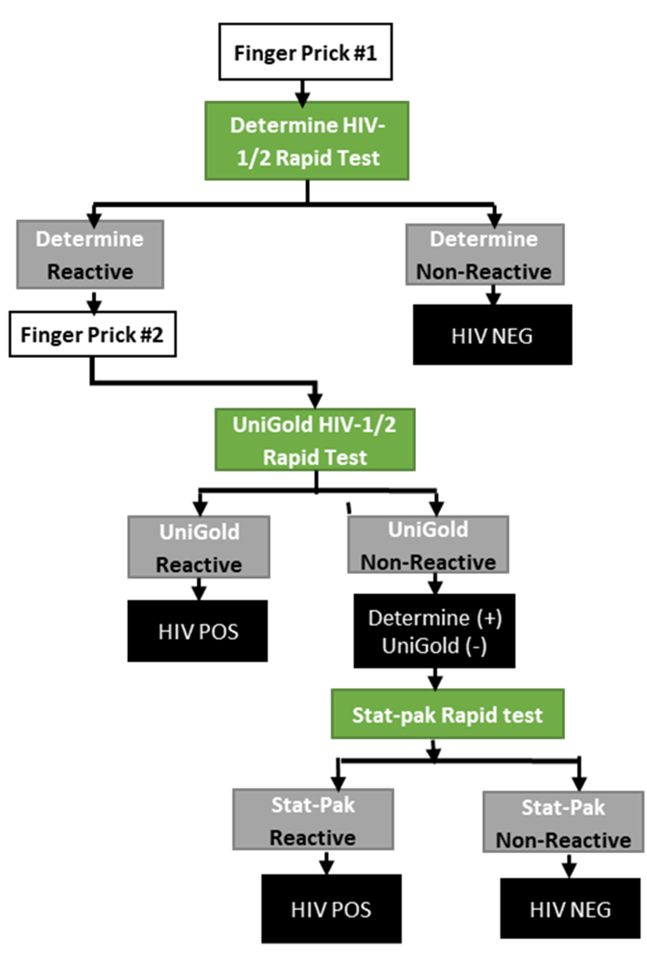
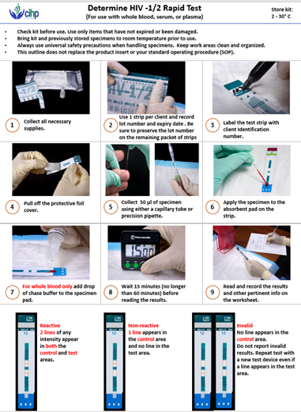


National Algorithm

Slide 12
Quality Initiatives
Collaboration and Training
Collaborations with PMTCT and Prevention/HTS Team.
Competency Assessment
Testers across:
QC and PT
New testers
Lot validation
RTK last mile distribution
CBOs Offices
OSS
Onsite mentoring
CART
CBOs
PMV
DTS-Based QC at host/hub facility.
Storage and inventory of RTK
Supply of quality kits

Slide 13
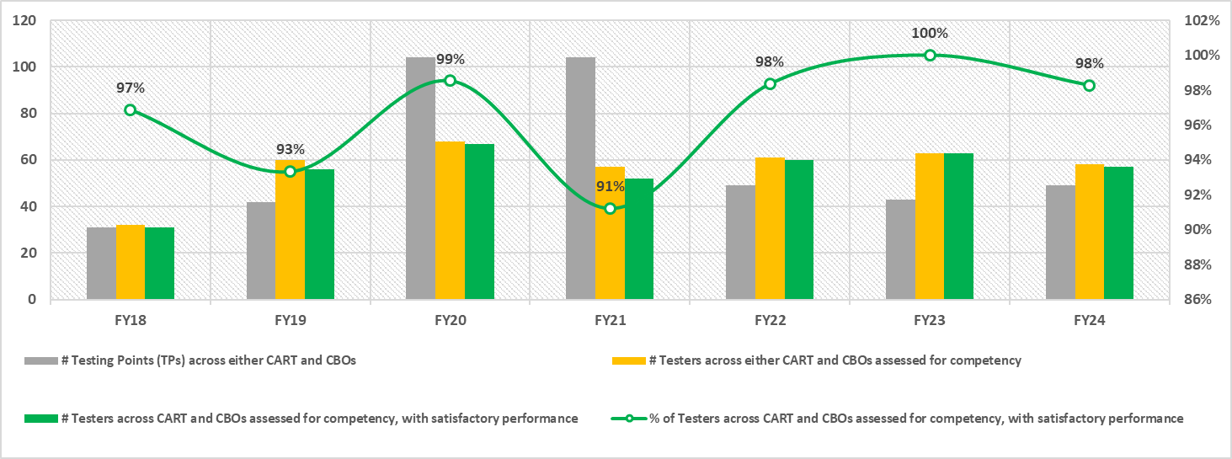
Competency Assessment for Community Testers

Slide 14
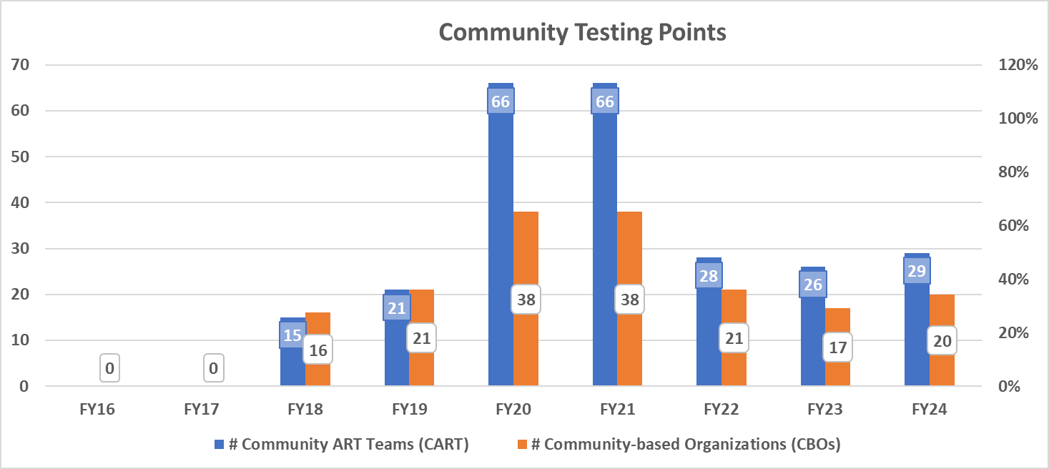
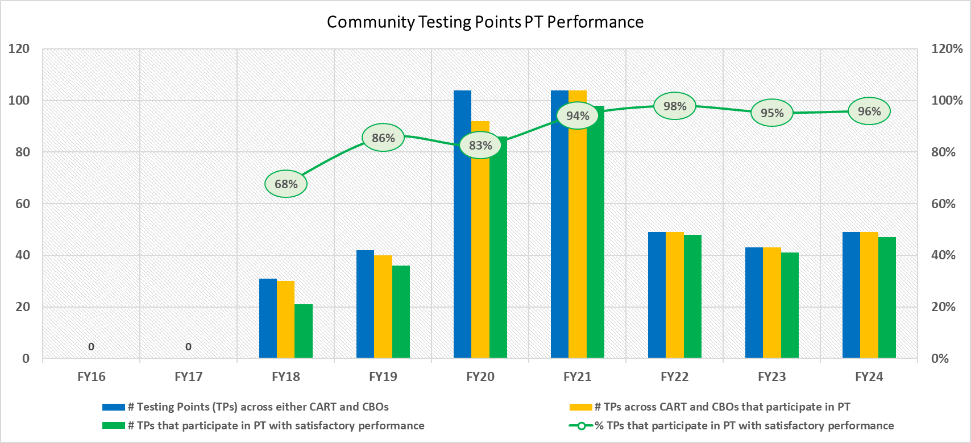
PT for Community Testers on National Algorithm Tests

Slide 15
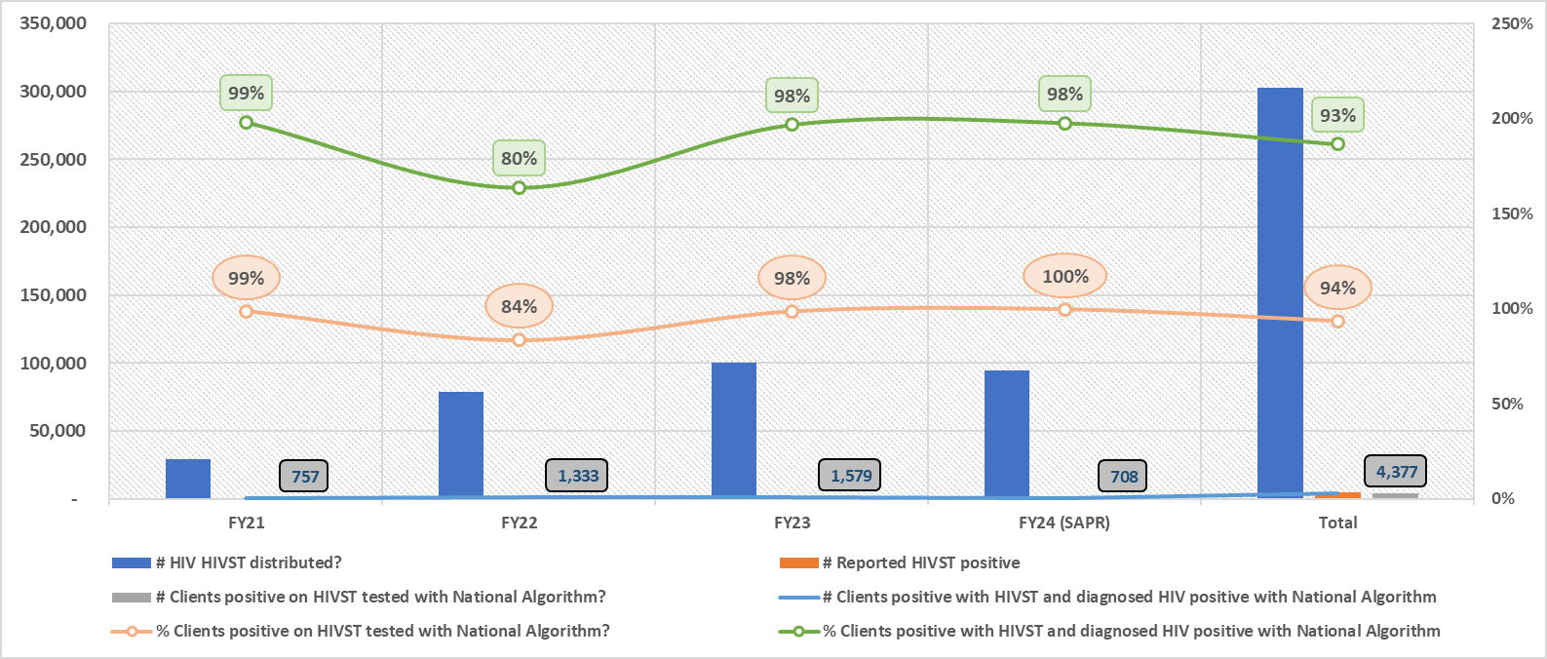
HIV Self Testing and National Algorithm Testing

Slide 16
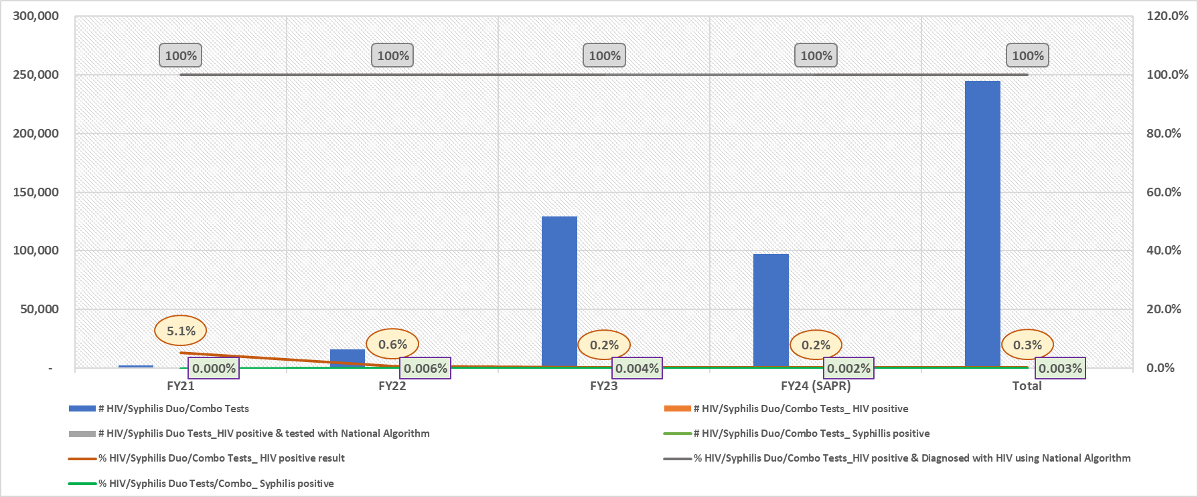
HIV/Syphilis Duo/Combo Tests and National Algorithm Tests

Slide 17

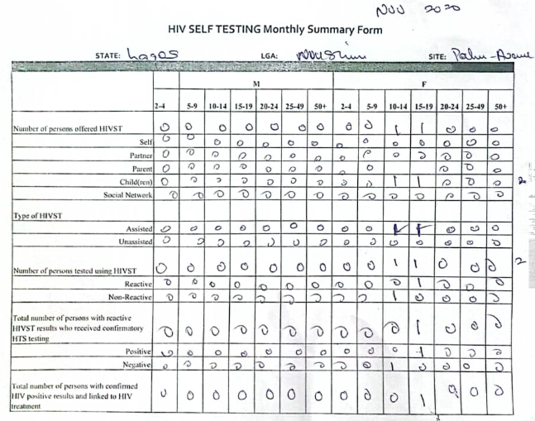
HIV Self Testing Data Tools

Slide 18
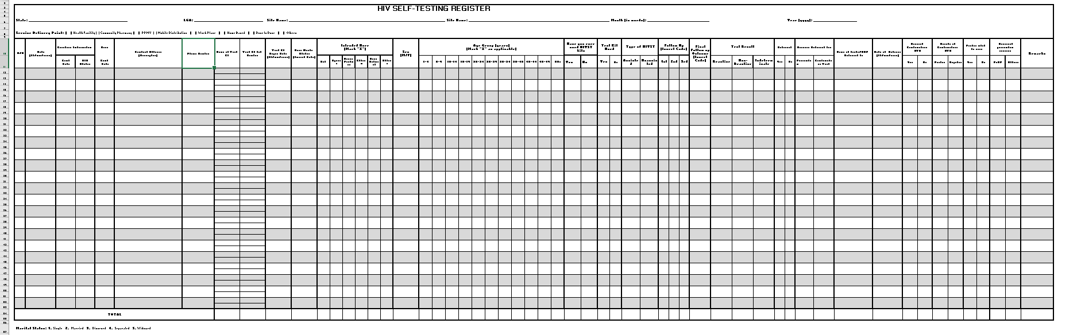
HIV Self Testing Register
Have you ever used HIVST kits?
Type of HIVST: Assisted or Unassisted?
Test Kit Used
Follow Up (1st, 2nd, 3rd), Final Follow-up
Test Result (Reactive, Non-Reactive, Indeterminate)
Services Referred For: Prevention or Confirmatory test?
Name of Facility/SDP Referred to
"Date of Referral(dd/mm/yyyy)"
Received Confirmatory HTS: Yes/No?
Type of Confirmatory Test?
Results of Confirmatory HTS (Positive or Negative)
Positive linked to care: Yes/No?
Accessed prevention services? PrEP?/Others?
"Intended User(Mark "X")
Self
Spouse
Sexual Partner
Children
Social Network
Others

Slide 19
Program Challenges and Recommended Actions
S/N | Program Challenges | Actions
1. | Access to brothel-based KP | Blended ‘non-numerated’ benefit package to clients and gate keepers/owners
2. | High attrition among testers. | Continuous Training
3. | Non availability of quality control program for: Syphilis HIVST | Mainstream learnings from RTCQI Best Practice Workshop at SA. Serial dilutions for DTS-based plasma
4. | Preference for Traditional Birth Attendants (TBAs) | Expand the scope of the Community quality program to include the TBAs.
5. | (Re)emerging Security concerns | Safe ‘out-of-community’ approaches for capacity building and leveraging on the ‘applicable’ technology.

Slide 20
Layered Opportunities for Improvement
Capacity development and pooled of trained testers (tester’s certification
Partnership and collaborations with Traditional Birth Attendant (TBAs)
Deploy application but comprehensive RTCQI package
Expand RTCQI for correct HIV results for epidemic control and zero litigation

Slide 21







As we enable and involve communities to lead and own their programs, we should do that with QUALITY in our minds, and not just the NUMBERS (as ‘targets’)
RTCQI Assures Quality of HIV Testing.
Thank you
Acknowledgement:

